Slide 1
Used Cars Dataset: Data Analysis and Predictions
Done by : Jyothiradithya,Gowthan,Santhosh Baba,Arun,Suriya,Komathy

Slide 2
Framework
01
02
03
04
Data Cleaning and preperation
Exploratory data analysis
Handling missing values, Outliers treatment
Categorical,Numerical,Univaritate,Bivariate analysis
Visualization
Linear Regression Model
Different plots to visualize the data and get trend or patterns and insights
Train Test and split the model and get the prediction with price as dependent variable

Slide 3
Data Description
Brand | Different Brands of cars
Year | Model year
Milage | Car mileage
Fuel Type | Car Fuel type – Petrol,Disel,Gasoline,Hybrid
Colour | Car colours - Green,white,blue
Accident | Accident history or none reported
Data of total 4009 rows and 11 columns where given in which there are 57 unique brands and 106 unique models of cars
The processes to be involved in this are :
1. Data Cleaning and preperation
2. Eda(Exploratory data analysis)
3. Visualization – Finding trends
4. Linear Regression M.l Model
Said data where given with total 11 variables:
1. Categorical : 6
2. Numerical : 4
3. Boolean : 1
Price | Price of Car in $
Engine Horsepower | Horsepower of different cars
Engine Displacement | Engine capacity in litres
Transmissions | Manual, or Automatic
Models | Availible Car different variants

Slide 4
Data Pre Processing
Based on pre processing of the data we came across :
Missing Values - Missing values in fuel type and accident columns were handled
2. Duplicate Data - Duplicate data are dopped
3. Unnecessary Columns - Clean title and interior colour columns were dropped
4. Renaming - Exterior colour was renamed into car colour
5. Cleaning text data - Unwanted characters ,strings are numbers are separated, Engine column was split into horsepower and displacement
6. Numerical Data cleaning - Mileage and price columns were cleaned by removing symbols an transmission column is converted to numeric
7. Outlier Detection - Outliers where detected using standard deviation
8. Handling Outliers - Price skewness was reduced using log transformation.

Slide 5
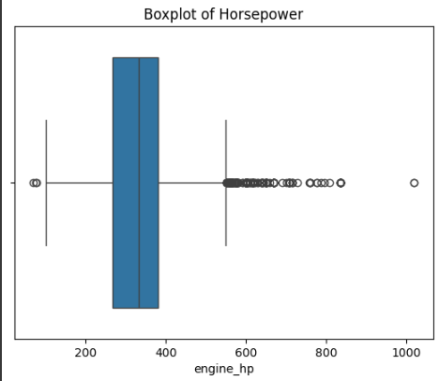
Outliers Detection using Boxplot
1. Outliers Detected: The box plot reveals extreme values (outliers) beyond the whiskers, indicating cars with unusually high or low prices, mileage, or engine power.
2. Impact on Model Performance: Outliers can distort regression models by increasing error metrics (MSE, RMSE), leading to biased predictions.
3. Possible Causes of Outliers: These could be due to luxury/exotic cars, data entry errors, or rare models with significantly different characteristics.

Slide 6
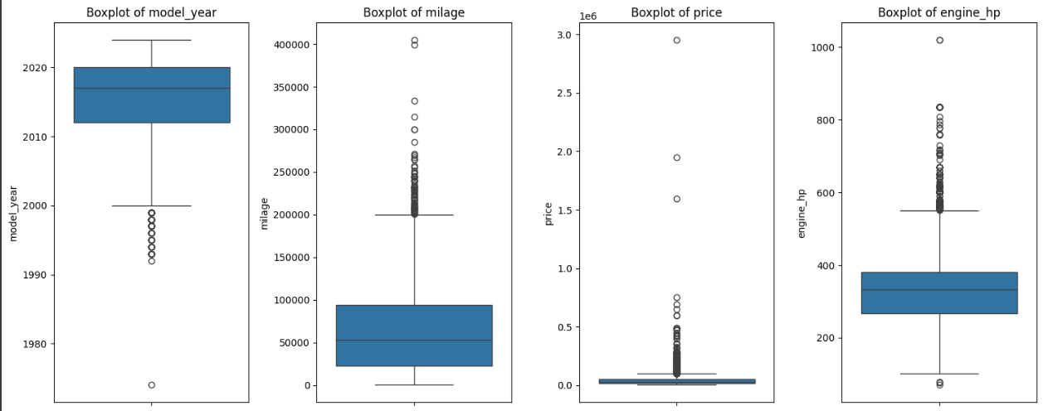
Outliers detected in different columns
Statistic
Boxplots of model year, price, and engine reveal outliers, indicating rare models, luxury cars, or data anomalies.
Mercury is the closest planet to the Sun and the smallest one in the Solar System—it’s only a bit larger than the Moon

Slide 7
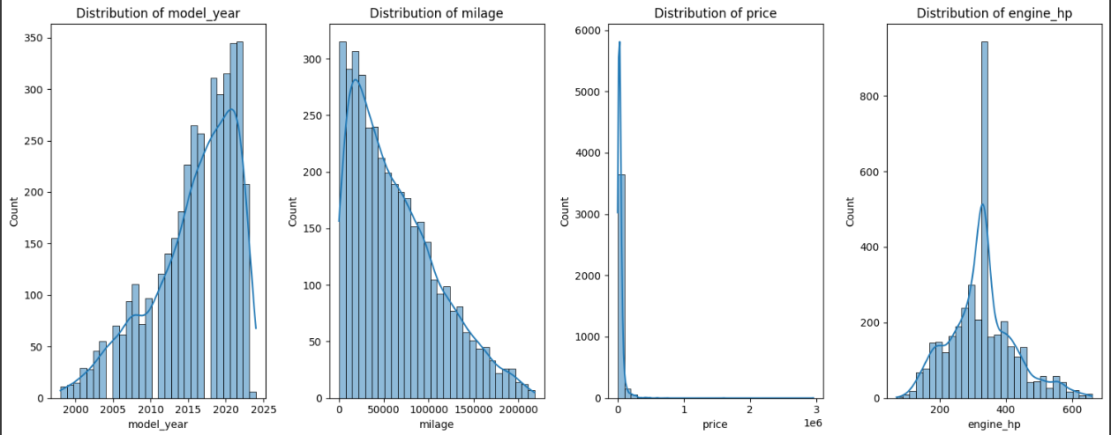
Outliers detected using Histplots
Line chart
Histogram analysis reveals outliers as extreme peaks or isolated bars, indicating rare values in model year, price, and engine.
Venu

Slide 8
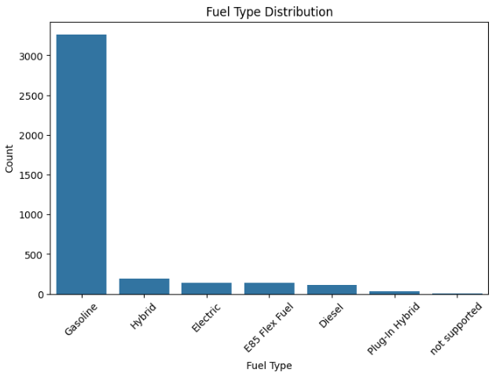
Fuel Type Distribution
The electric/hybrid is low,market still favours gasoline
The plot shows that the gasoline is the most used fuel type in the dataset. This shows its accessible and affordable in many regions
Other fuel type like hybrid, electric diesel have significant lower counts which show s there are fewer adoptions or lower available models

Slide 9
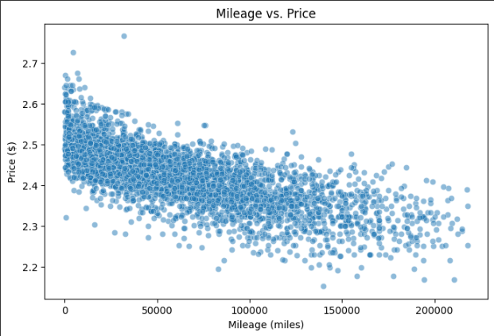
Relationship between Mileage and Price
There is negative slope which means higher mileage cars are cheaper
As the mileage of the car increases the price of the car tends to decrease
The cars with lower mileage are at higher price because they are less used and are in better conditions
The graph is dense at lower mileage cars which are most cars and are less driven
Area chart
Venus is the second planet from the Sun
Pyramid chart
Jupiter is the biggest planet of them all
Bar chart

Slide 10
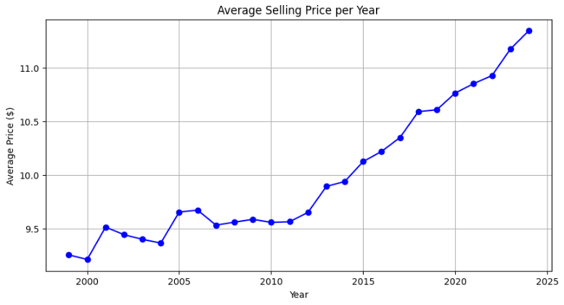
Average Car Sales per year
This graph shows average selling price of cars per year
The newer cars are most expensive than older cars because of the new features
Older cars show lower price maybe because of the aging and old features in the car
The market shows clear preference for newer cars

Slide 11
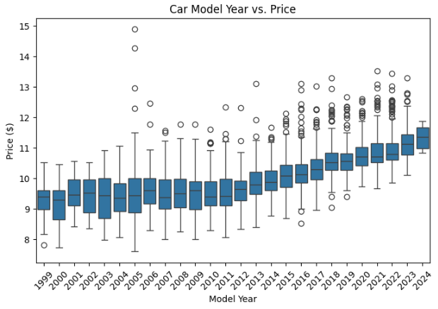
Model year vs Price
It has a positive correlation newer cars are at higher prices because of the advanced features
Older cars price is lower this shows market perception that older cars have less utility and values
Older cars boxplots are more wider and they have greater variability in price and newer cars boxplots are less wider and they have less variability in price

Slide 12
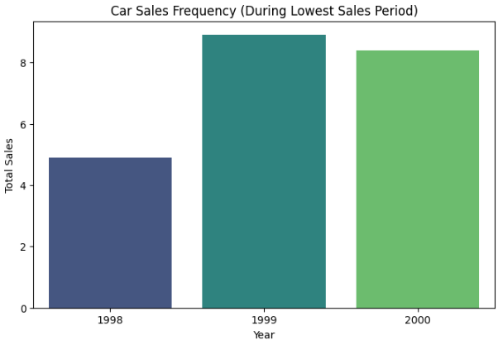
Car sales at Lowest sales period
The year 1999 recorded the highest car sales in the lowest selling period
This graph shows car sales frequency in the lower sales period which are 1998,1999,2000 respectively

Slide 13
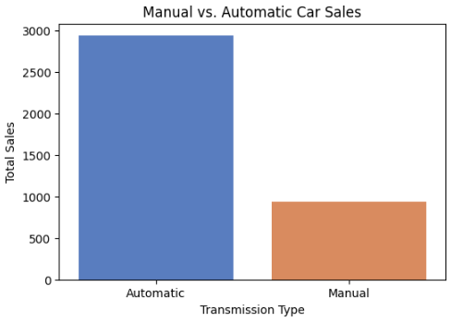
Automatic Vs Manual Cars
The graph shows the automatic cars out number the manual cars
The buyers prefer ease and comfort of driving offered by the automatic car transmissions over the manual ones

Slide 14
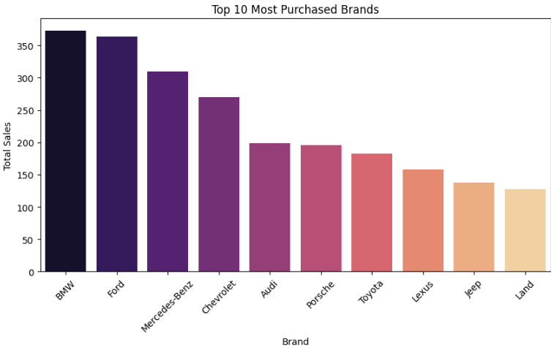
Top Selling Car Brand
The top selling cars are BMW and Ford which are the most selling cars
This is a graph showing the top 10 top selling brands of cars in all time

Slide 15
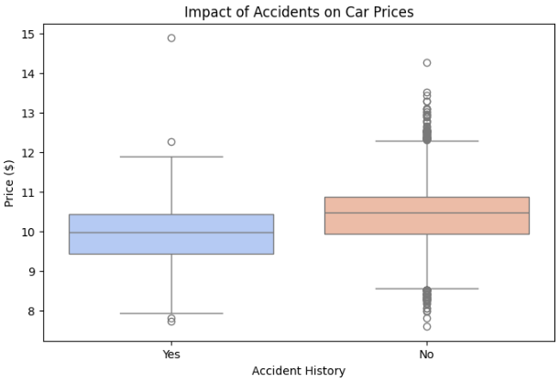
Accidents impact on Car prices
The boxplot shows that the cars which are reported with accidents are at lower prices compared to cars with none accidents reported are at higher prices
This shows buyers feel less reliable to damaged vehicles history and costlier to maintain

Slide 16
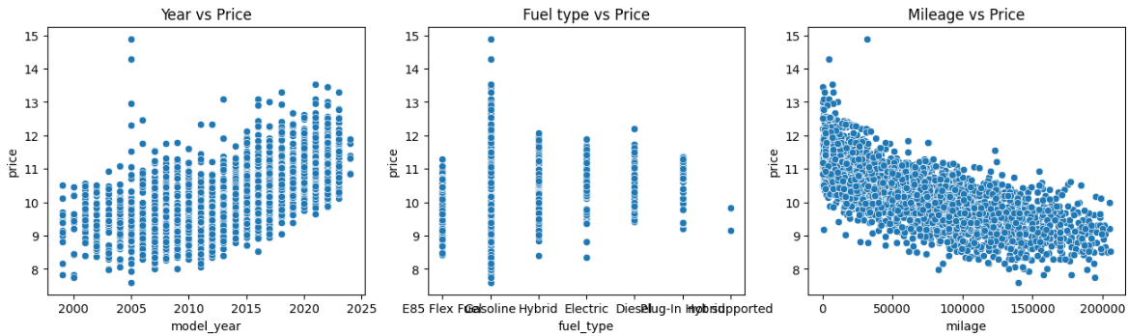
Relationship between year,price,fuel type and mileage
Price increases with newer models because of updated features,reliability
Price Decreases has milelage increases

Slide 17
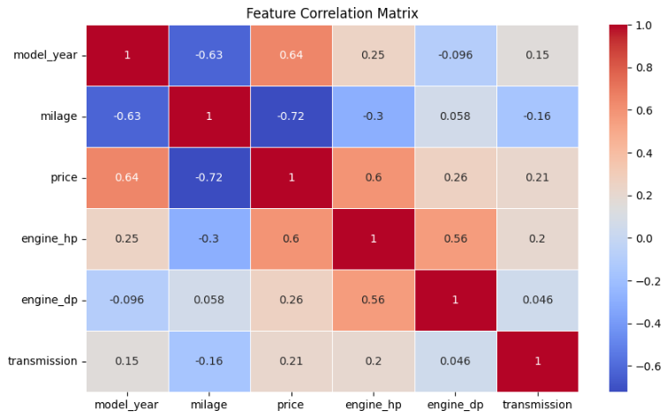
Correlation Matrix
As the horsepower increases the price of the vehicle tends to increase
Mileage has negative correlation with the price it is expected because the higher mileage cars are often less expensive
Newer model cars are negatively corelated because they have lesser miles on them
Features like accident history have weaker correlation with price because they have less impact on pricing decisions
.

Slide 18
Linear Regression Model
We used Linear Regression to predict car prices based on key features like model year, mileage, engine power, and fuel type.
Categorical variables were converted using one-hot encoding, and the dataset was split into training (75%) and testing (25%).
The model was trained on the training set, and predictions were made on the test data to evaluate performance.
We calculated MAE, MSE, RMSE, and R² to assess prediction accuracy, where lower errors indicate better model performance.
The Mean Absolute Percentage Error (MAPE) helped us understand the relative error percentage in price predictions.
The model’s accuracy can be enhanced by handling outliers, feature selection, and non-linear transformations for better real-world predictions.
Extreme

Slide 19
Conclusion
Extreme values in price, mileage, and engine power suggest unique cases such as luxury cars or data errors, influencing model predictions.
Most used cars are priced between $11,000–$13,000, indicating a strong demand in this affordability range.
Automatic cars dominate the market, showing a buyer preference for convenience over manual transmissions.
Older cars have significantly lower prices, reflecting the natural depreciation effect in the automotive market.
Higher engine horsepower correlates with higher prices, as performance-oriented vehicles attract premium pricing.
Gasoline-powered vehicles are the most common, with limited representation of hybrid and electric cars, indicating slower adoption.
Cars from 2023 had the highest number of sales, while prices peaked in 2024, reflecting increasing demand for newer models.
The Range Rover dominates peak sales, while Montero and GTR lead during low sales periods, highlighting distinct consumer preferences.
Cars with accident history are priced lower, indicating buyers’ hesitation in purchasing potentially unreliable vehicles.
Higher mileage decreases car prices, as buyers associate more mileage with wear and tear.

Slide 20
Actionable Insights
should price cars around $11,000–$13,000 for maximum market interest and affordability.
Given the high demand for automatic cars, manufacturers should focus marketing efforts on this segment.
Incentives or promotions for hybrid and electric cars could improve their market presence.
Higher-priced, high-horsepower vehicles should be positioned as premium offerings to attract performance-focused buyers.
Sellers of accident-history cars should highlight high-quality repairs and certifications to retain pricing value.
Establish clear depreciation models based on mileage to provide transparent and competitive pricing.
Extreme

